Slide 1


Cyberbullying and Fake Account Detection in Social Media
Vivekanand Education Society’s Institute Of Technology
Department Of Computer Engineering
Project Review 2
Mentor Details:
Name: Prof. Richard Joseph
Designation: Asst. Prof. VESIT
Group Members:
Jayesh Samtani D17A-57
Sagar Sidhwa D17A-62
Somesh Tiwari D17A-71
Riya Wadhwani D17A-74
Notes:
NOTE:
To change the image on this slide, select the picture and delete it. Then click the Pictures icon in the placeholder to insert your own image.

Slide 2
Index
Introduction
Lacuna in the existing System
Problem Statement
Literature Survey
Hardware, Software, tools and the constraints
Modular Diagram of the Project (Also DFD, Use Case diagram / ER Diagram)
Methodology employed
Algorithms Implemented
Implementation Details (Flowchart, GUI Screenshots, Dataset Used)
Results Obtained (Screenshots)
Conclusion
Future Scope
References
Review Sheet 1 (Semester VIII)
Details of paper Published

Slide 3
Introduction
Cyber Crime and Bullying have increased on Social Networking sites with having more than 50 Crores active users until now, so the misuse of the Online Social Platform had taken place in several times for e.g Bullying Someone by sending the harmful messages ,spreading of the harassment messages by using the fake accounts, using the abusive words on the social media etc
In a recent report it was found that nearly 25% of People, especially teens and young adults are finding new ways to bully one another over the Internet and parents don’t know that their child has been involved in a cyberbullying incident.
A Preventive measure to STOP the above crimes caused a need for different Machine Learning algorithms for detection of the Cyber Crime and Bullying and the fake accounts so as to report these issues to the system immediately and to stop the crimes to increase in future and develop a secure online environment.

Slide 4
Lacuna In The Existing System
1] Lack of Security -There is a lack of Security in the existing systems but our system will deal with the proper security provision to the users.
2] No Transparency- As the existing system doesn’t provide the proper transparency in their system as they are not able to deal with the Sharing of their reports to the Cybercrime Department.
3] Costly to Produce Reports - The other systems will cost a lot to generate the reports but the system that we will develop will generate results and reports for free.

Slide 5
Problem Definition
Nowadays, cybercrime is one of the common issues everyone is facing and it is impacting the people, in which some are long period of sadness, anger, irritability, loss of interest in activities, being restless, anxious and worried, even in some cases they go into depression and take steps to scarify their life.It is unfortunate that there are no special Anti-Cyberbullying Laws in India yet.There are some common types of cyberbullying that is Flaming, Harassment, Denigration,Impersonation,Trickery. So to detect cyberbullying we have to make some software that will detect it and then report it to www.cybercrime.gov.in. Similarly, we will detect fake accounts.

Slide 6
Literature Survey
Title : Fake Twitter accounts: Profile characteristics obtained using an activity-based pattern detection approach
Link : https://people.clarkson.edu/~jmatthew/publications/SMS_gurajala_original.pdf
Inference : From this paper we got the information about the fake account dataset quantity, because due to the low number of false positives of fake account data accuracy of model decreased even if the twitter profile database was approx 60 million.
Title : Detection of Behavior Patterns through Social Networks like Twitter, using Data Mining techniques as a method to detect Cyberbullying
Link:https://www.researchgate.net/publication/322514911_Towards_the_detection_of_cyberbullying_based_on_social_network_mining_techniques
Inference : In the analysis stage we use data mining techniques to generate a dictionary of pejorative terms that are related to cyberbullying and thus be able to generate behavior patterns of these terms. And in this way provide better tools so that psychology specialists can optimize their work.
Title : Classification of Cyberbullying in Facebook Using Selenium and SVM
Link : https://www.researchgate.net/publication/327635426_Classification_of_Cyberbullying_in_Facebook_Using_Selenium_and_SVM
Inference : In this paper facebook data were used for classification using Support Vector Machines (SVM) models. A total of 2263 data was used for training data, Facebook posts.

Slide 7
Hardware, Software Specifications
Tools
Intel Pentium Processor
RAM>=4GB
Anaconda
Visual Studio
Django
Machine Learning Algorithms
Python Libraries
Windows 10 SDK
Constraints :
Continuous network connectivity required
Process or requirement varies according to the Dataset

Slide 8
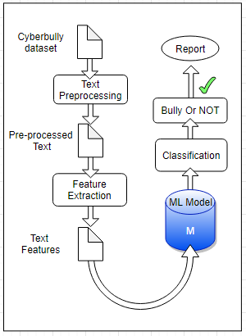
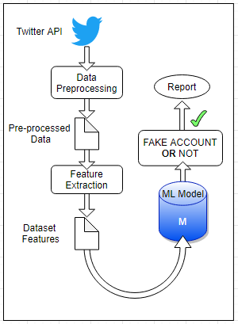
Modular Diagram

Slide 9
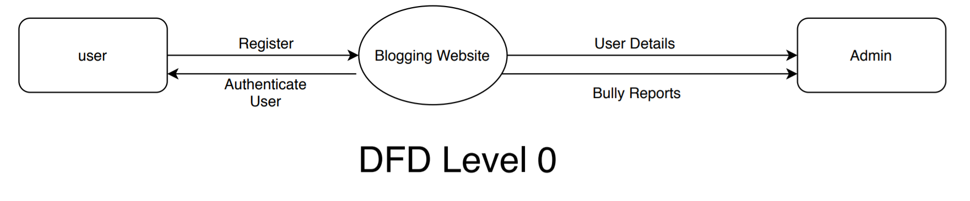
DFD Level 0

Slide 10
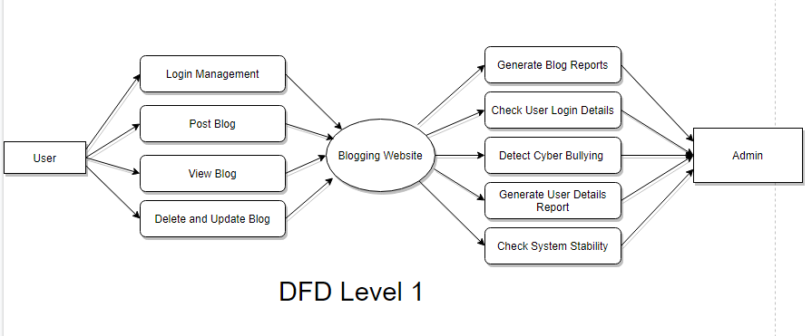
DFD Level 1

Slide 11
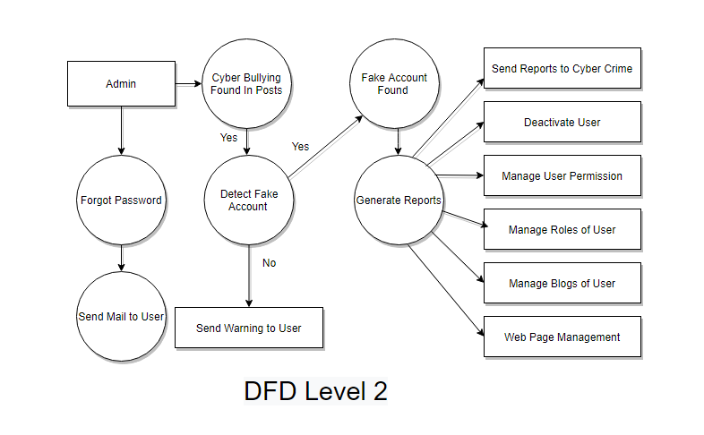
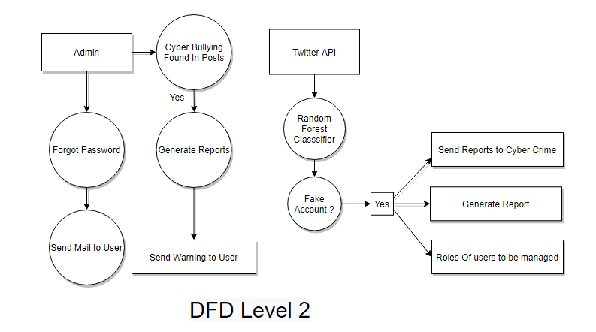
DFD Level 2

Slide 12
Methodology Employed
The proposed approach contains three main steps namely Preprocessing, features extraction and classification step.
In the preprocessing step from the Toxic dataset we had used the parameters - Toxic , Sever Toxic,Obscene,Insult,Threat,Identity hate and from the fake account dataset the parameters used are - Name, Status Count, Followers Count, Friends Count ,Url, Time Zone, Listed Count ,Screen Name ,Profile Bio,Location .
we clean the data by removing the noise and unnecessary text.
The preprocessing step is done in the following: -
Tokenization
Lowering text
Stop words and encoding cleaning
The second step of the proposed Model is the features extraction step. In this step the textual data is transformed into a suitable format applicable to feed into machine learning algorithms

Slide 13
Methodology Employed
The last step in the proposed approach is the classification step where the extracted features are fed into a classification algorithm to train, and test the classifier and hence use it in the prediction phase. We will use classifiers, namely, SVM (Support Vector Machine), Naive Bayes,Random Forest,Decision Tree , Logistic Regression.
Accuracy of different algorithms will be Compared to get the best possible result.
If offensive text is Found in the Post the details of users such as IP address,latitude ,longitude,ISP will be stored.
For the fake profile detection the detection process starts with the selection of the profile that needs to be tested. After selection of the profile the suitable attributes ie., features are selected on which the classification algorithm is being implemented ,the attributes extracted are passed to the trained classifier.

Slide 14
Algorithms Implemented
Random Forest
Random forest, like its name implies, consists of a large number of individual decision trees that operate as an ensemble. Each individual tree in the random forest spits out a class prediction and the class with the most votes becomes our model’s prediction
There are two stages in Random Forest algorithm, one is random forest creation, the other is to make a prediction from the random forest classifier created in the first stage. The whole process is shown below, and it’s easy to understand using the figure.
Here the author firstly shows the Random Forest creation pseudocode:
Randomly select “K” features from total “m” features where k << m
Among the “K” features, calculate the node “d” using the best split point
Split the node into daughter nodes using the best split
Repeat the a to c steps until “l” number of nodes has been reached
Build forest by repeating steps a to d for “n” number times to create “n” number of trees

Slide 15
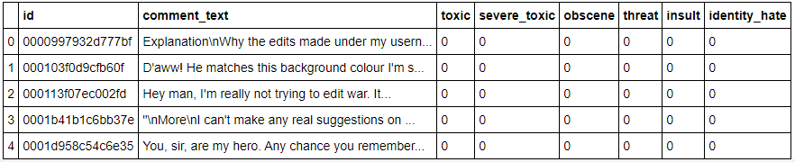
Implementation Details
//Dataset Used for Cyberbullying (Total Rows : 159571)

Slide 16
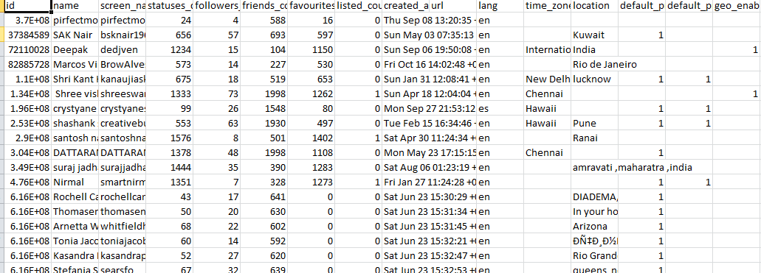
Implementation Details
//Dataset Used for Fake Account ( Total Rows : 3000)

Slide 17
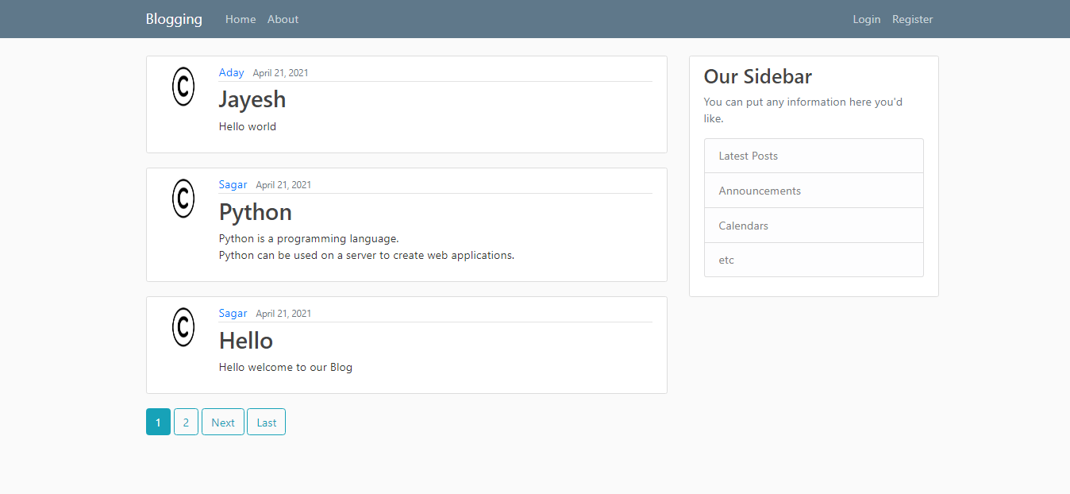
Implementation Details
//GUI Screenshots (Home Page)

Slide 18
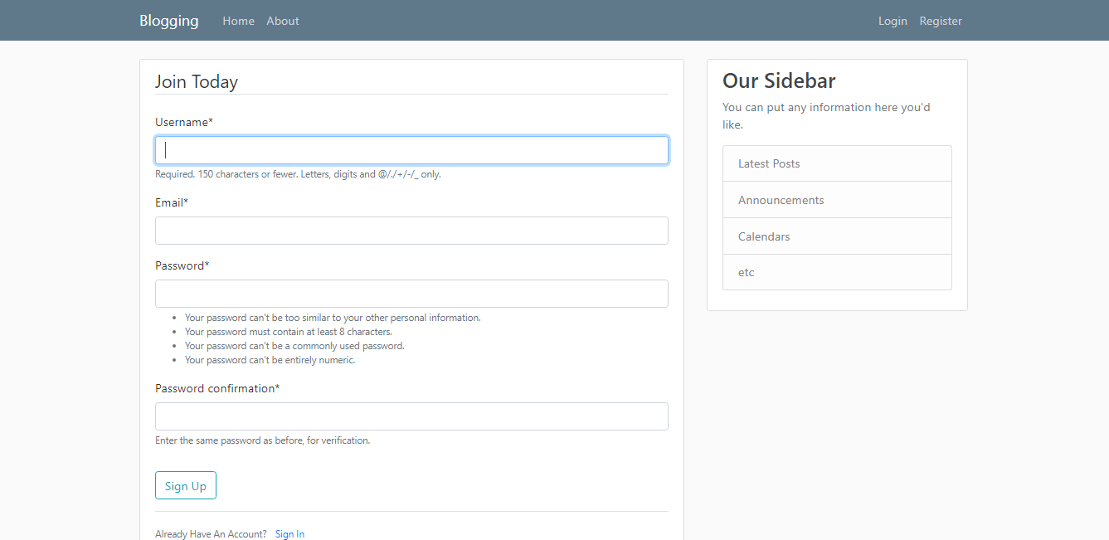
Implementation Details
//GUI Screenshots (Register page)

Slide 19
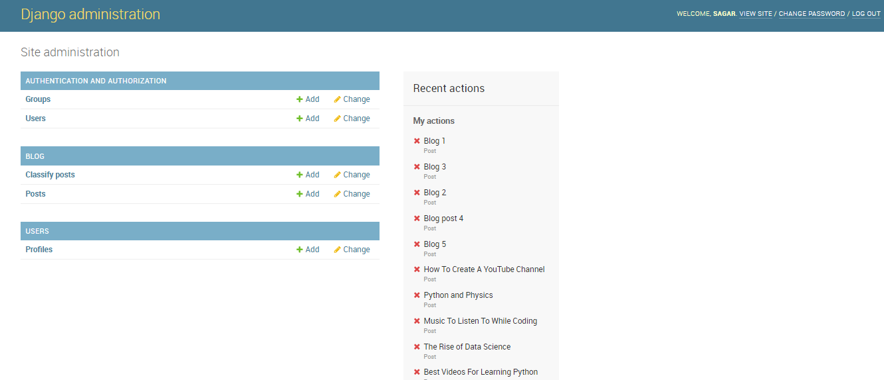
Implementation Details
//GUI Screenshots (Admin Page)

Slide 20
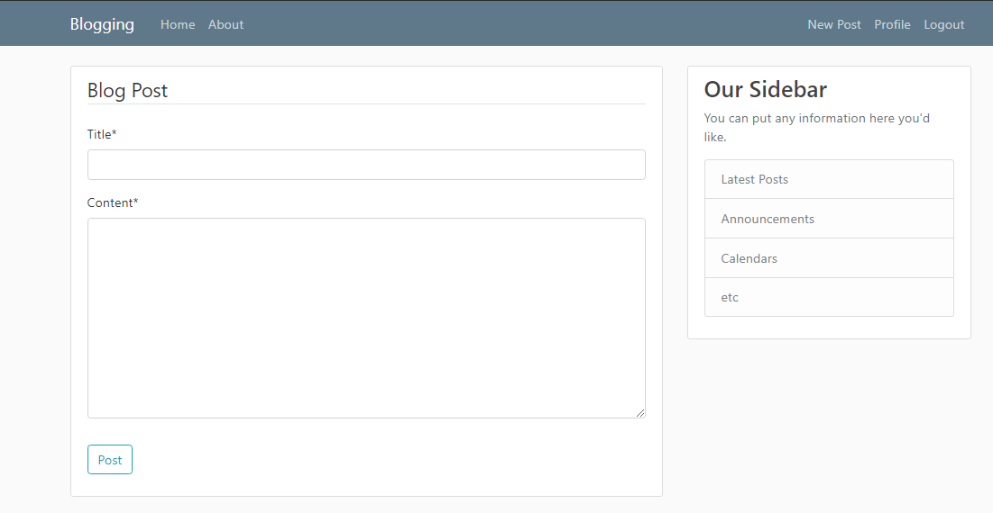
Implementation Details
//GUI Screenshots (New Post Page)

Slide 21
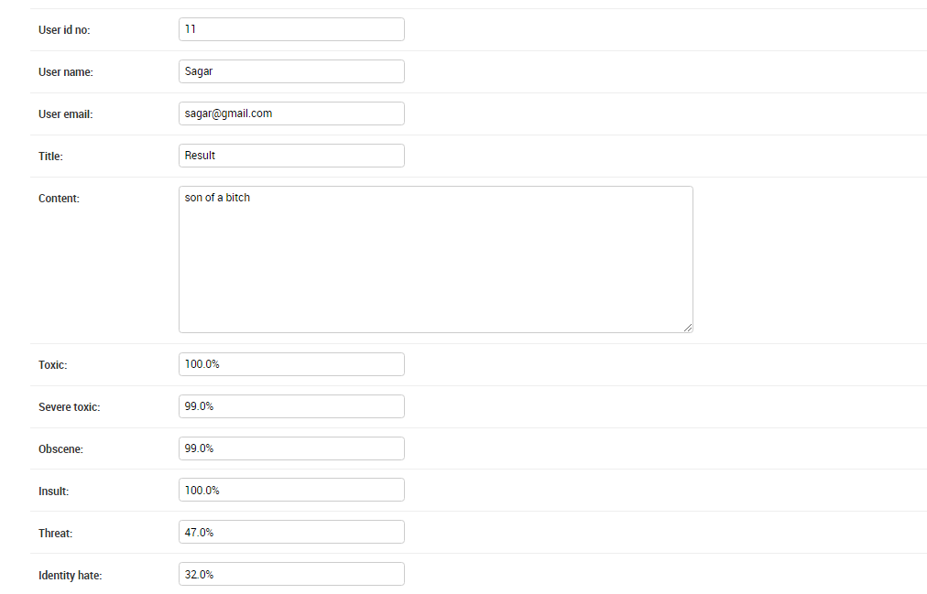
Results Obtained (Screen Shots)
//For Cyberbullying

Slide 22
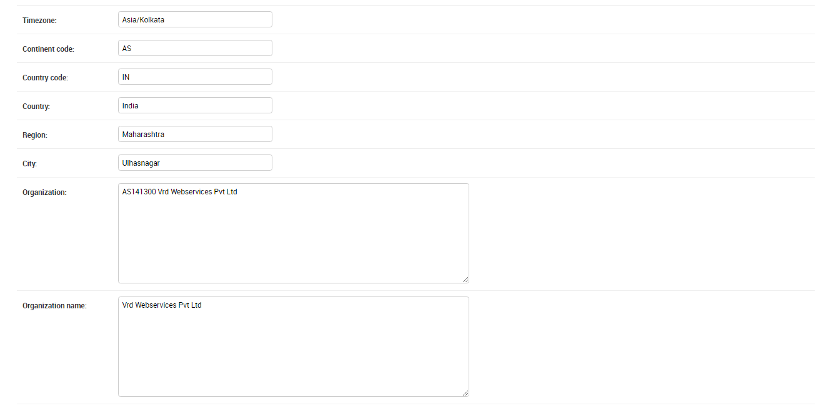
Results Obtained (Screen Shots)
//For Cyberbullying

Slide 23
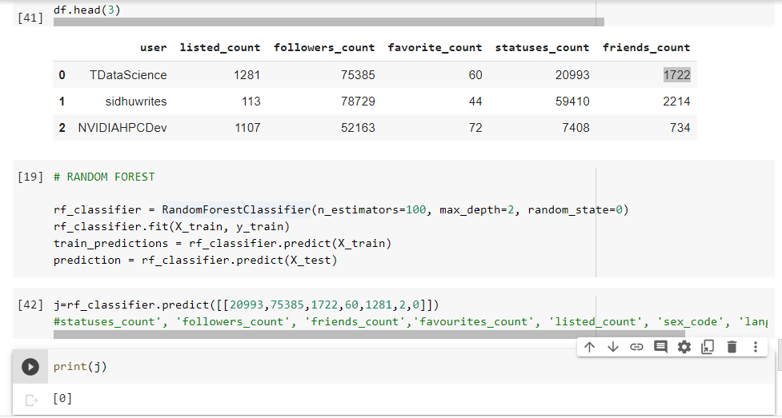
Results Obtained (Screen Shots)
//For Fake Account

Slide 24
Conclusion
In this project, we proposed an approach to detect Cyberbullying and comment classification as toxic,obscene,threat,insult,identity hate and Fake Account Detection using machine learning techniques.
We have evaluated our model on Different ML Algorithms and we have also used Countvectorizer for features extraction By using machine learning algorithms to its full extent.
We will eliminate the need for manual prediction of a fake account, which needs a lot of human resources and is also a time-consuming process.

Slide 25
Future Scope
To reduce the toxicity classification on the Double negative sentence
(For e.g “I don't have nobody to kill my time” )

Slide 26
References
S. Gurajala, J. S. White, B. Hudson, and J. N. Matthews, “Fake Twitter accounts: Profile characteristics obtained using an activity-based pattern detection approach,” in Proceedings of the 2015 International Conference on Social Media & Society , Toronto, Ontario, Canada, 2015.View at: Publisher Site | Google Scholar.
N. V. Chawla, K. W. Bowyer, L. O. Hall, and W. P. Kegelmeyer, “SMOTE: synthetic minority over-sampling technique,” Journal of Artificial Intelligence Research, vol. 16, pp. 321–357, 2002.View at: Google Scholar
I. Jolliffe, Principal Component Analysis, 2002.View at: MathSciNet.
S. Sperandei, “Understanding logistic regression analysis,” Biochemia Medica, vol. 24, no. 1, pp. 12–18, 2014.View at: Publisher Site | Google Scholar..

Slide 27
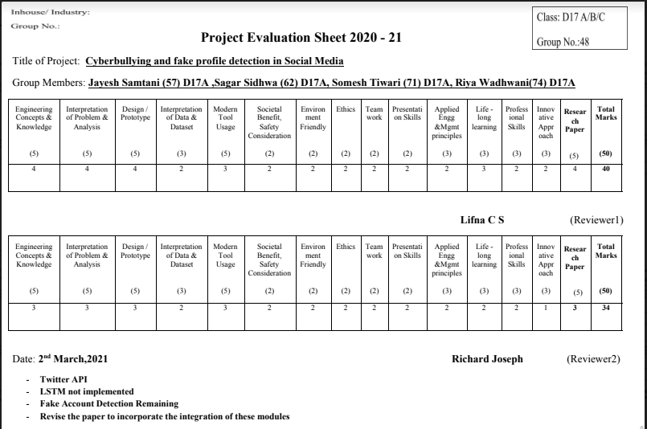
Review Sheet 1

Slide 28
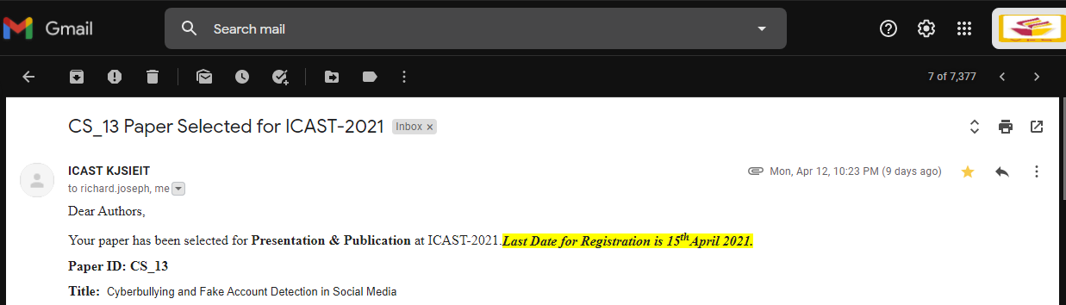
Details Of Paper Published

Slide 29
THANK YOU
Vivekanand Education Society’s Institute Of Technology
Department Of Computer Engineering

